Slide 1

Presidential Popularity:
A matter of sentiment?
By Lauren Ingrassia
Pratt Institute
INFO640 Final Presentation
Notes:
Basic analysis (across both sets)
NRC unique positive and unique negative vs. instance
Afinn (use for avg. coorelation. - normalize factor in # of lines)

Slide 2
Background
Today’s political administration seems to have a contentious and negative message that emphasizes conspiracy and deregulation over hope and progressive change.
This makes me feel bad.
Does this make other people feel bad? So, I wondered….

Slide 3
Does a president’s sentiment have an effect on their popularity?
To try to answer this question, I performed a text analysis of the State of the Union speeches and compared sentiment with presidential approval ratings.

Slide 4
The hypothesis
Are there topics or tone that cluster or correlate with presidential approval?

Slide 5
Research
To complete the study, I will employ text and sentiment analysis techniques as well as descriptive and comparative statistical analysis.
The “SOTU” package in R provides the raw text from each State of the Union for the text comparison.
Gallup approval polls started in the 1930s and the State of The Union corpus ends before 2017. My analysis and comparison will start with F.D. Roosevelt, the 32nd President, to President Barack Obama.
I will also take a deeper dive into the analysis of State of the Union Messages as a whole.

Slide 6
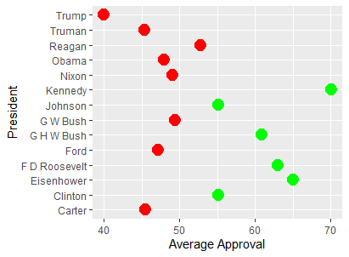
Approval Ratings
To start, I created a data table using information from historic Gallup point in time approval polls and imported it into RStudio to do further analysis
Notes:
How do I reorder? Do approval by quarter to see if they correlate with sotu. Bigger data set

Slide 7
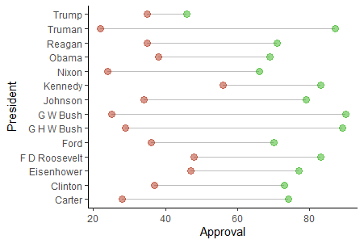
Approval Ratings
Plotting the highs and lows was interesting. We see here that
G.W. Bush had the largest approval spread (the 9/11 effect)
Trump has lowest spread and most consistent ratings
Kennedy & FDR were the most consistently popular presidents
Notes:
Reorder this too

Slide 8
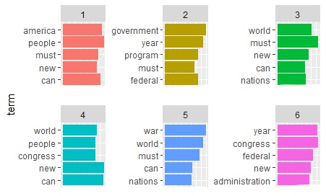
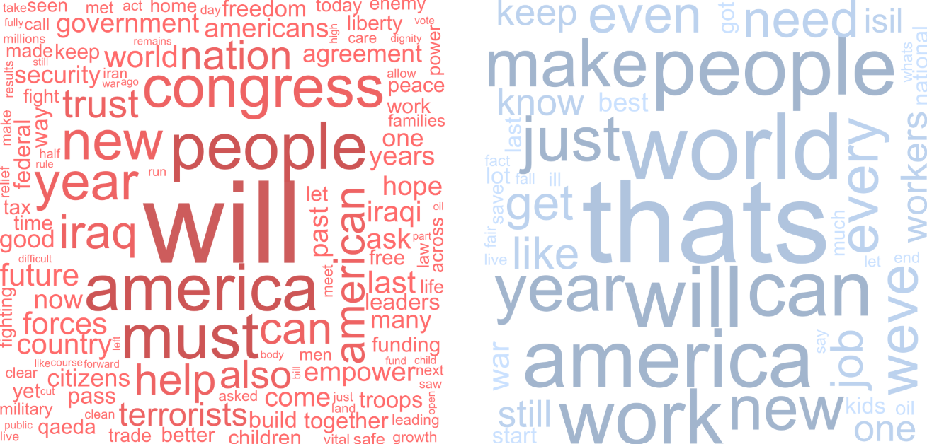
State of the Union Text Analysis
Methods:
Text prep (soooo much text prep)
Topic clustering
Top words for each president
Percent of positive vs. negative sentiment
Word clouds (because they’re fun)
Notes:
How do I show the full cloud in R?

Slide 9
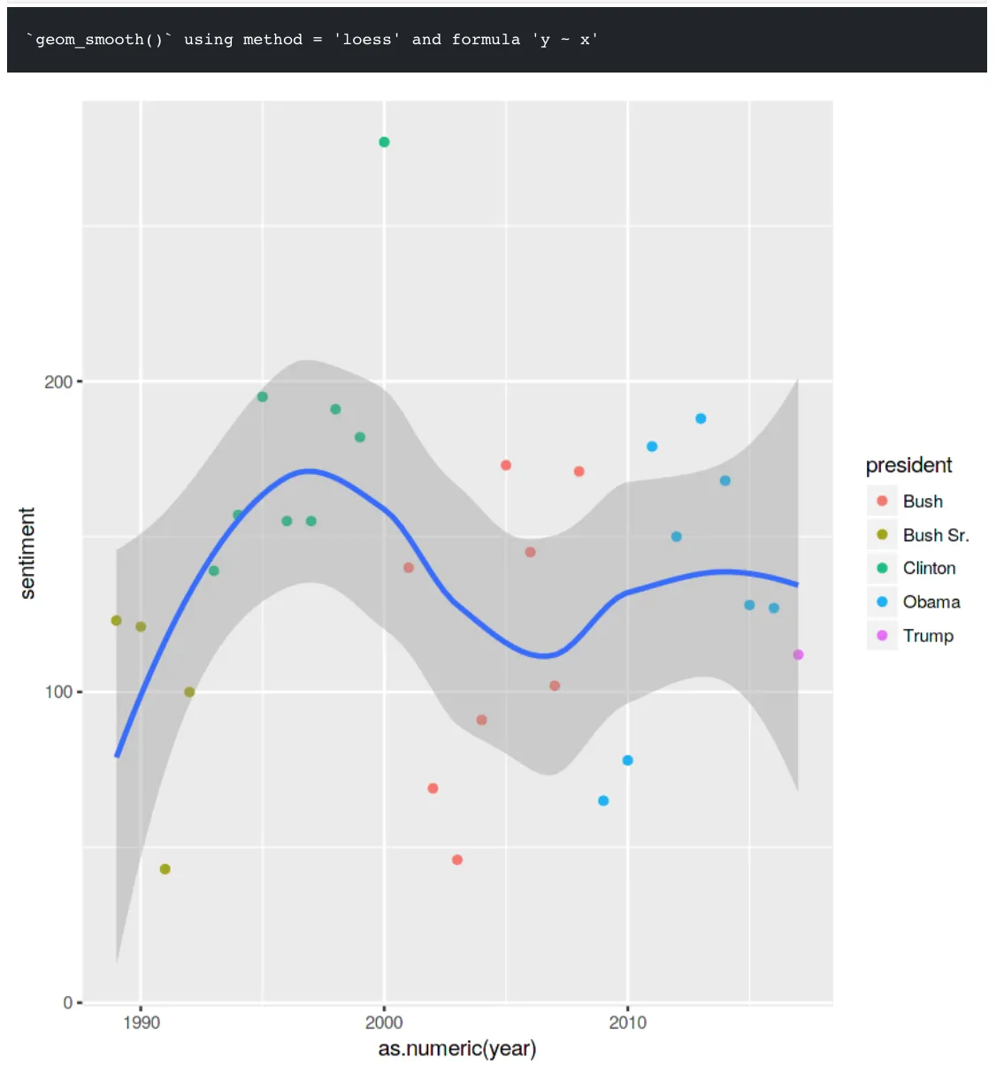
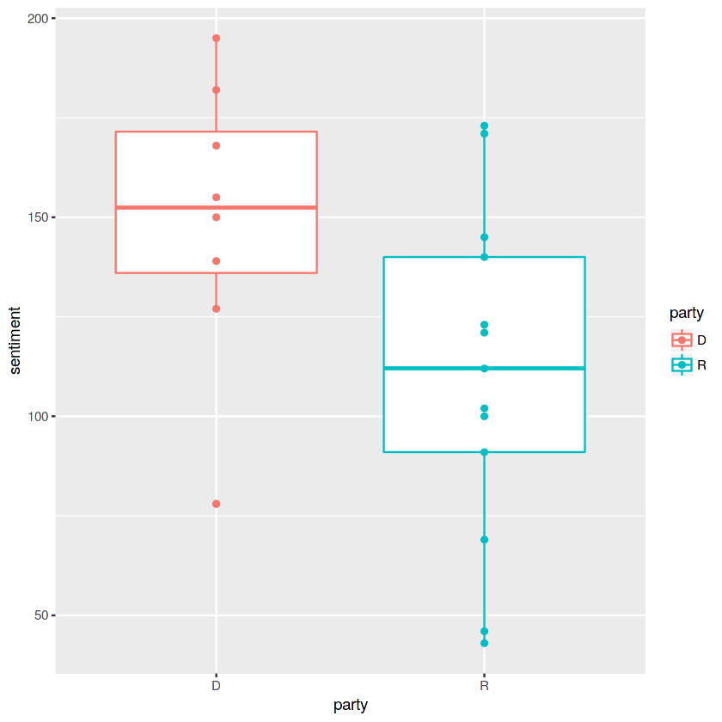
State of the Union
The SotU generally is skewed, positive for each president, likely because it is a formal speech.
If we group sentiment by party, there is more of a difference.
Democrats tend to be more positive.
https://www.kaggle.com/rtatman/tutorial-sentiment-analysis-in-r
Charts by Rachel Tatman
Notes:
Positivity ratio – positive/negative

Slide 10
Putting it all together.

Slide 11
Conclusion
Based off of the current data, I believe that there will be a small correlation between sentiment and presidential approval.
However, through my exploratory analysis of the different variables, it seems as if factors such as party, economy, and other national trends have more of an influence on popularity.

Slide 12

What is next?
This paper and analysis will conclude with a plotted regression analysis to see if there is a significant correlation between sentiment and popularity among presidents.

